Slide 1
Transportation of Company workers for the reduction of traffic and pollution
Felipe Ríos López
Santiago Gil Zapata
Medellín, 16/05/2019

Slide 2
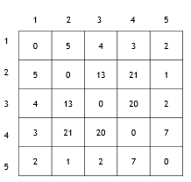
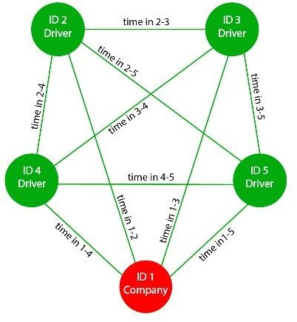
Data Structures
Figure 1: A matrix with the weights of the paths.
Figure 2: Structure of a complete graph

Slide 3
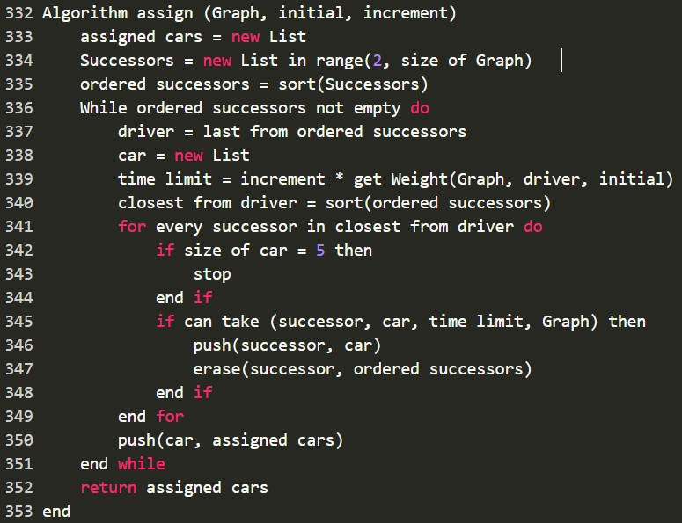
Algorithm and Complexity
Method | Complexity
Graph creation | O(n2)
Sorting | O(n2)
Erase | O(n)
canTake | O(n)
Assign | O(n3)
-------------------- | --------------------
Total = | O(n3)

Slide 4
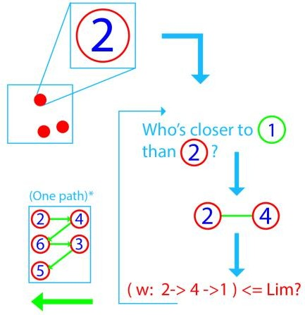
Algorithm design criteria
-It is fast
-Only uses the related data, and that reduces completely the needed storage.
-Reduces the traffic in a 69.5% for the worst case P=1.1

Slide 5
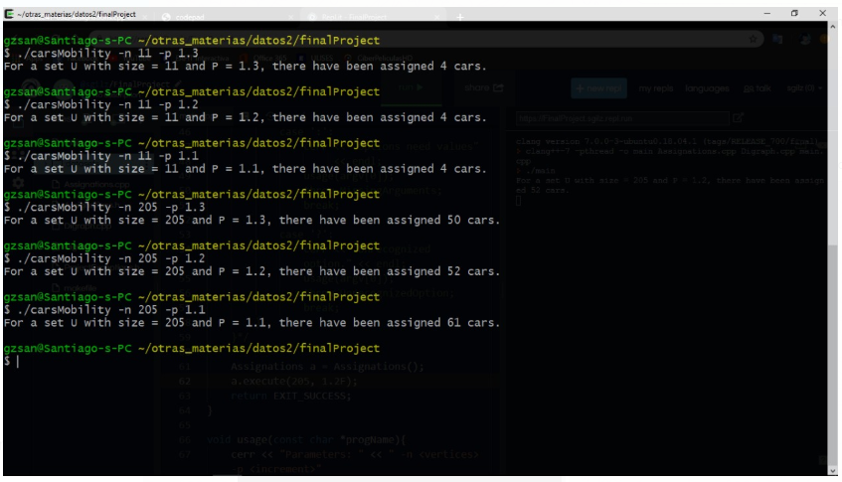
Execution

Slide 6
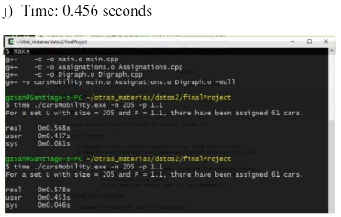
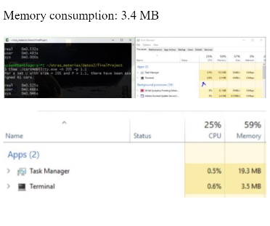
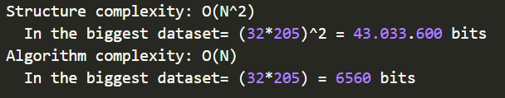
Time and Memory Consumption

